Slide 1


Generative AI

Slide 2
Italian LLMs
Italian LLMs (Large Language Models) refer to language models that are specifically designed to understand and generate text in the Italian language.
Training Data: Italian LLMs are typically trained on large datasets that include a wide range of Italian text, such as books, articles, websites, and other written content. This helps the model learn the nuances of the language, including grammar, vocabulary, and idiomatic expressions.

Slide 3
Italian LLMs
Popular Models: Some well-known LLMs that support Italian include multilingual models like BERT, GPT, and T5, which have been fine-tuned on Italian datasets. Additionally, there may be specific models developed by Italian research institutions or companies that focus on the Italian language

Slide 4
DanteLLM
DanteLLM: Let’s Push Italian LLM Research Forward
Andrea Bacciu et al. (2024) focuses on bridging the gap in resources and evaluation tools for non-English LLMs, with a specific focus on the Italian language.
Two new Italian LLMs, DanteLLM and OpenDanteLLM, are proposed. DanteLLM, while limited for commercial use due to training data licensing, excels in performance. OpenDanteLLM, on the other hand, is fully open-source, allowing for broader use in both academic and industrial applications.

Slide 5
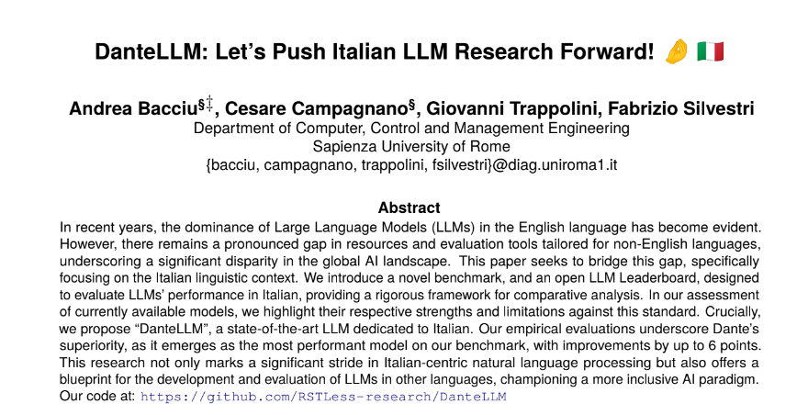

Slide 6
Analysis on Evaluating 7B Italian LLMs
Authors, Alessandro Ercolani and Samuele Colombo, maintainers of the Italian Leaderboard, have contributed to the lm-evaluation-harness by adding evaluation tasks for different languages, particularly Italian. They evaluated various open-source Italian models on these tasks and shared their data and findings in this article.

Slide 7
Analysis on Evaluating 7B Italian LLMs
Evaluation Metrics: The LLMs were evaluated using metrics like HellaSwag (sentence completion), MMLU (multitasking), ARC-c (reasoning and commonsense knowledge), Belebele (machine reading comprehension), Lambada (language modeling), and Xcopa (causal commonsense reasoning).
Key Findings: The authors observed that no model improved on the MMLU_IT metric compared to the base Mistral-7B-v0.1 model, suggesting potential trade-offs between broad language knowledge and specific task performance. They also found that Maestrale models performed well on Belebele and Hellaswag tasks, while Zefiro models excelled on Lambada.
Conclusion: The authors conclude that fine-tuned open-source models trained on single GPUs can improve upon foundational base models by an average of 5% on the considered evaluation tasks. They emphasize the importance of evaluation in the LLM ecosystem and suggest that with more training time and data, further improvements are possible.

Slide 8
A new benchmark for evaluating Italian LLM
MMLU-Pro-ita is a new benchmark for evaluating Italian LLMs. It is a curated translation of the original MMLU-Pro dataset, designed to assess language understanding across broader and more challenging tasks.
The translation process involved using Claude Opus from Anthropic with a prompt engineering technique. This ensured high-quality, professional translations that accurately preserved mathematical terms and notations.
The results of the evaluation show that microsoft/Phi-3-medium-4k-instruct is the best performer. However, the author notes that models in the Phi-3 family are trained on synthetic data, mostly in English, and may not speak Italian very well.
Fine-tuned models like DeepMount00/Llama-3b-Ita and mii-llm/maestrale-chat-v0.4-beta showed significant improvement over their base models. This suggests that they were trained on high-quality datasets for the mmlu-pro-it task.
The author emphasizes that evaluations and benchmarks can only serve as indicators of model performance and cannot be used to judge a model for a particular use case. They also predict a rise in domain specialization of LLMs and the development of new benchmarks for specific domains.

Slide 9
References
https://huggingface.co/blog/giux78/analysis-on-ita-llm
Andrea Bacciu, Cesare Campagnano, Giovanni Trappolini, and Fabrizio Silvestri. 2024. DanteLLM: Let’s Push Italian LLM Research Forward!. In Proceedings of the 2024 Joint International Conference on Computational Linguistics, Language Resources and Evaluation (LREC-COLING 2024), pages 4343–4355, Torino, Italia. ELRA and ICCL https://aclanthology.org/2024.lrec-main.388/

Slide 10


Q&A

